Slide 1

Life Cycle Optimization (LCO) with PULPO 🐙
Presenter:
Fabian Lechtenberg
Research Groups:
Sustainable Process Systems Engineering Lab (SUPERLab)
Center for Process and Environmental Engineering (CEPIMA)

Slide 2


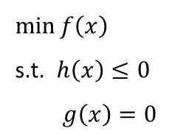
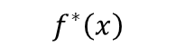
What is Lifecycle Optimization?
Lifecycle Assessment (LCA)
Goal and Scope Definition
Lifecycle Assessment based Optimization
Heat
$\min{f\left(x\right)}$
s.t. $h\left(x\right)≤0$
$$g\left(x\right)=0$$
Inventory Analysis
C
Interpretation
A
B
D
+
Impact Assessment
Electricity
$$f^{∗}\left(x\right)$$
Integration of LCA, TEA, Process Simulation and Optimization: A systematic review: Ferdous, et al. (2023).

Slide 3



What is Lifecycle Optimization?
Lifecycle Assessment (LCA)
Goal and Scope Definition
If optimization (also) in background:
“What if …”
or
“Under which circumstances …”
Inventory Analysis
Interpretation
If optimization only in foreground:
“How to achieve …”
Optimization 🖥
Impact Assessment

Slide 4
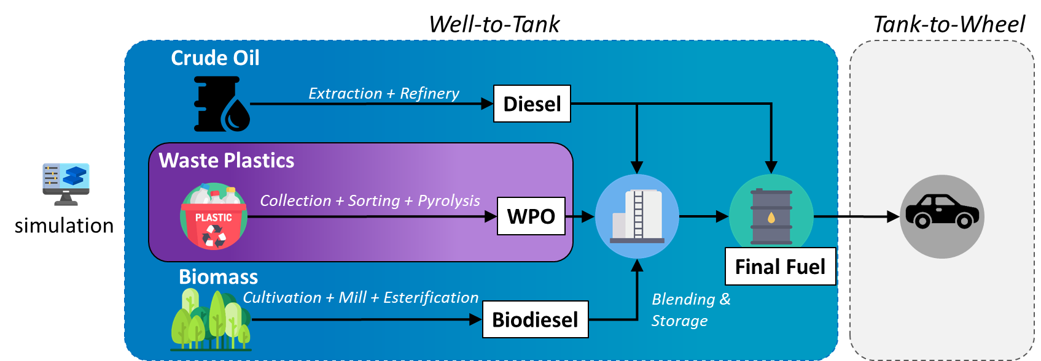
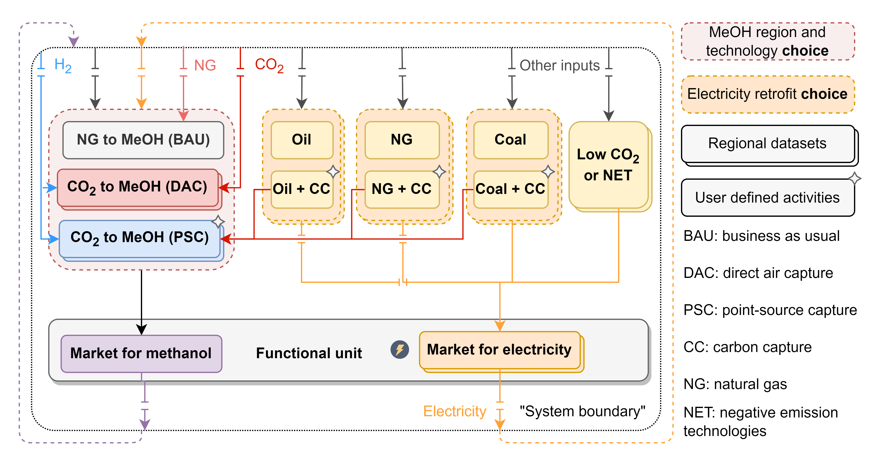
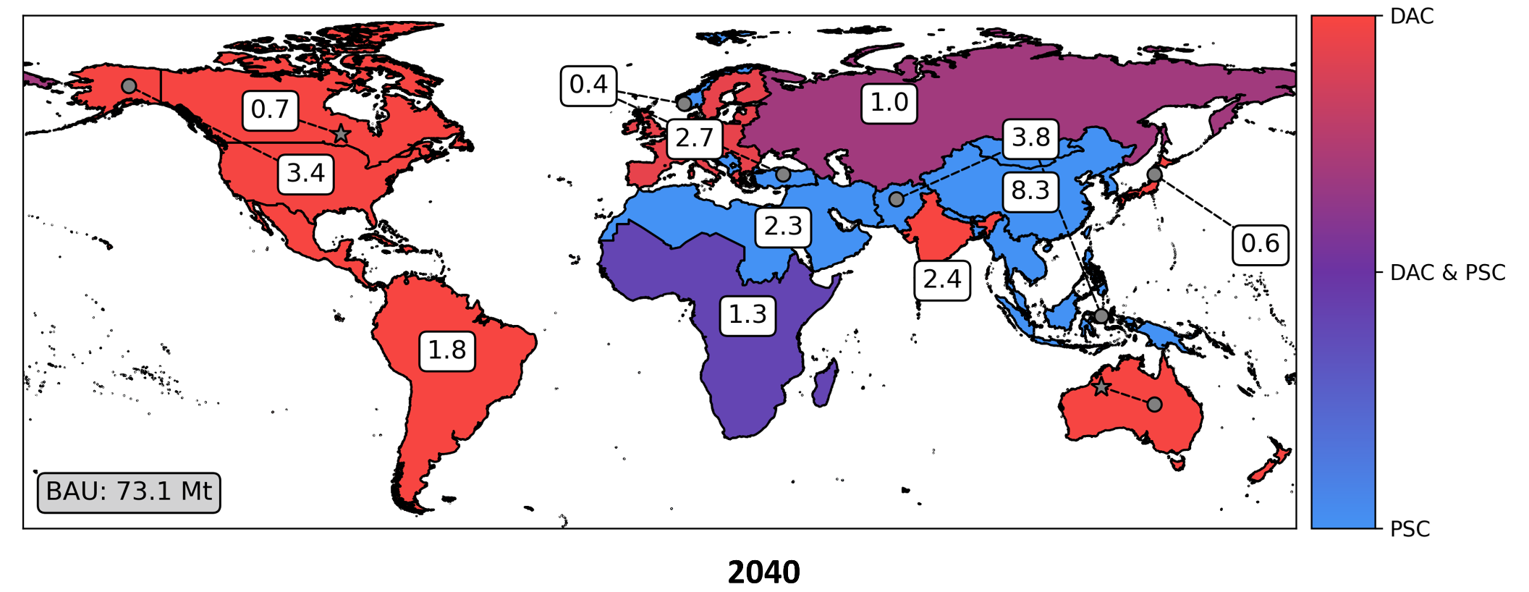
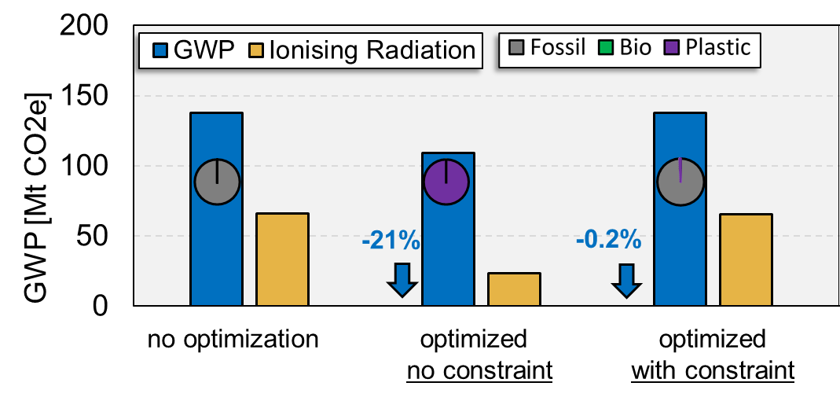


What can be done with PULPO? [Examples]
Plastic Pyrolysis
Sector Coupling
“Given plastic waste availability, to what extent can our innovative recycling process make an impact?”
“According to the prospective background systems, how much carbon is (will be) available, and where to utilize it efficiently?”

Slide 5



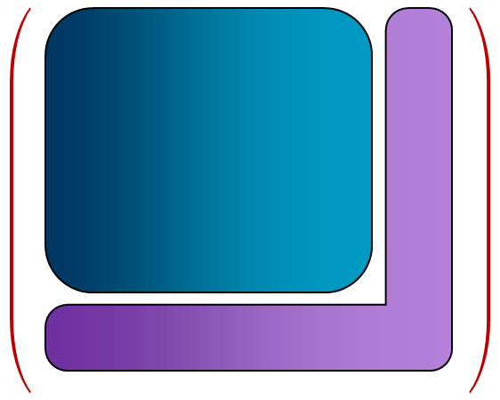



PULPO
Python-based User-defined Lifecycle Product Optimization
📦 Functional Unit
Goal
&
Scope
🔄 Choices
🎯 Objective Function
⚙️ Constraints
converter
LCI + User Database
parser
solver
Optimization Model
(optional)
saver
Results
save_results()
summarize_results()

Slide 6

















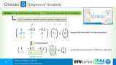
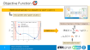




User Inputs
As in any regular LCA!
Technology / Region
📦 Functional Unit
Goal
&
Scope
🔄 Choices
🎯 Objective Function
⚙️ Constraints
Impact Categories
Any sort of Limitation

Slide 7
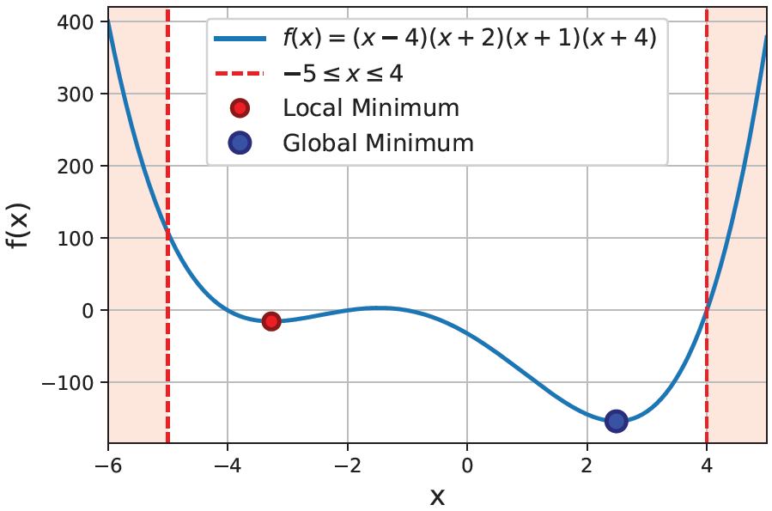
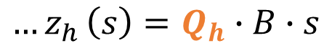
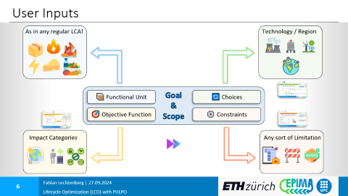
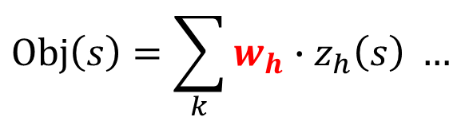

Objective Function 🎯
Mathematical Expression that measures how “good” a system is!
Also specifies what “good” actually is
Relative importance of impact categories
In PULPO, this is …
$$Obj\left(s\right)=\sum_{k}{w_{h}∙z_{h}\left(s\right)} …$$
$${…z}_{h}\left(s\right)=Q_{h}∙B∙s$$
Characterization factors

Slide 8
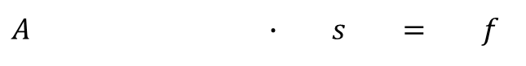
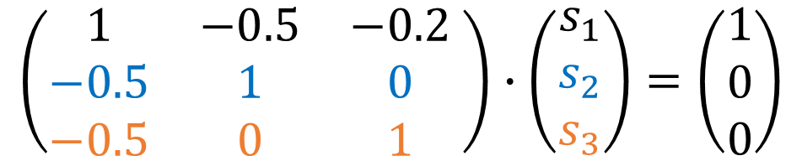
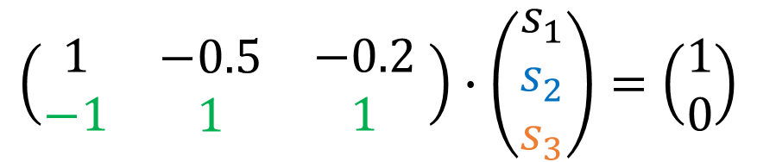
Choices 🔄 [Degrees of Freedom]
Variables in the mathematical model (e.g. “$x$”) that are not specified by circumstances
Can be varied to find the optimal system configuration
$A ∙ s = f$
$$\left(\begin{matrix}1 & −0.5 & −0.2 \\ −0.5 & 1 & 0 \\ −0.5 & 0 & 1\end{matrix} \right)∙\left(\begin{matrix}s_{1} \\ s_{2} \\ s_{3}\end{matrix}\right)=\left(\begin{matrix}1 \\ 0 \\ 0\end{matrix}\right)$$
Square and invertible → unique solution!
“rectangularize”
$$\left(\begin{matrix}\begin{matrix}1 \\ −1\end{matrix} & \begin{matrix}−0.5 \\ 1\end{matrix} & \begin{matrix}−0.2 \\ 1\end{matrix}\end{matrix} \right)∙\left(\begin{matrix}s_{1} \\ s_{2} \\ s_{3}\end{matrix}\right)=\left(\begin{matrix}1 \\ 0\end{matrix}\right)$$
Underdetermined system → infinite solutions!
process choice

Slide 9

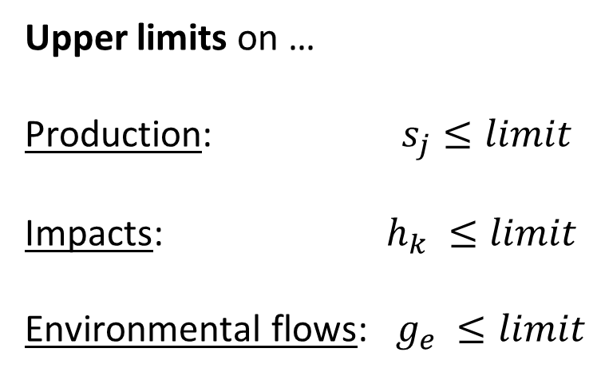
Constraints ⚙️
Equation (equalities & inequalities) that impose restrictions on the variables
Represent physical, conceptual, or regulatory limitations
Upper limits on …
Production: $s_{j}≤limit$
Impacts: $h_{k} ≤limit$
Environmental flows: $g_{e} ≤limit$
Lower limits on production are also posible …

Slide 10
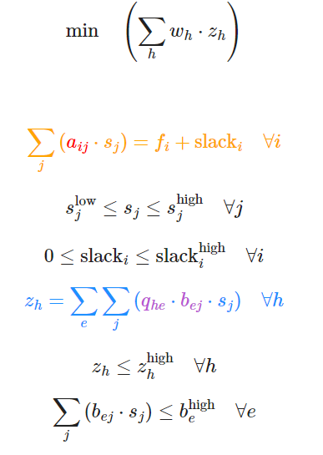

Optimization Problem
Objective Function 🎯
subject to
Choices 🔄
Optimized Production System!
Constraints ⚙️
Constraints ⚙️

Slide 11
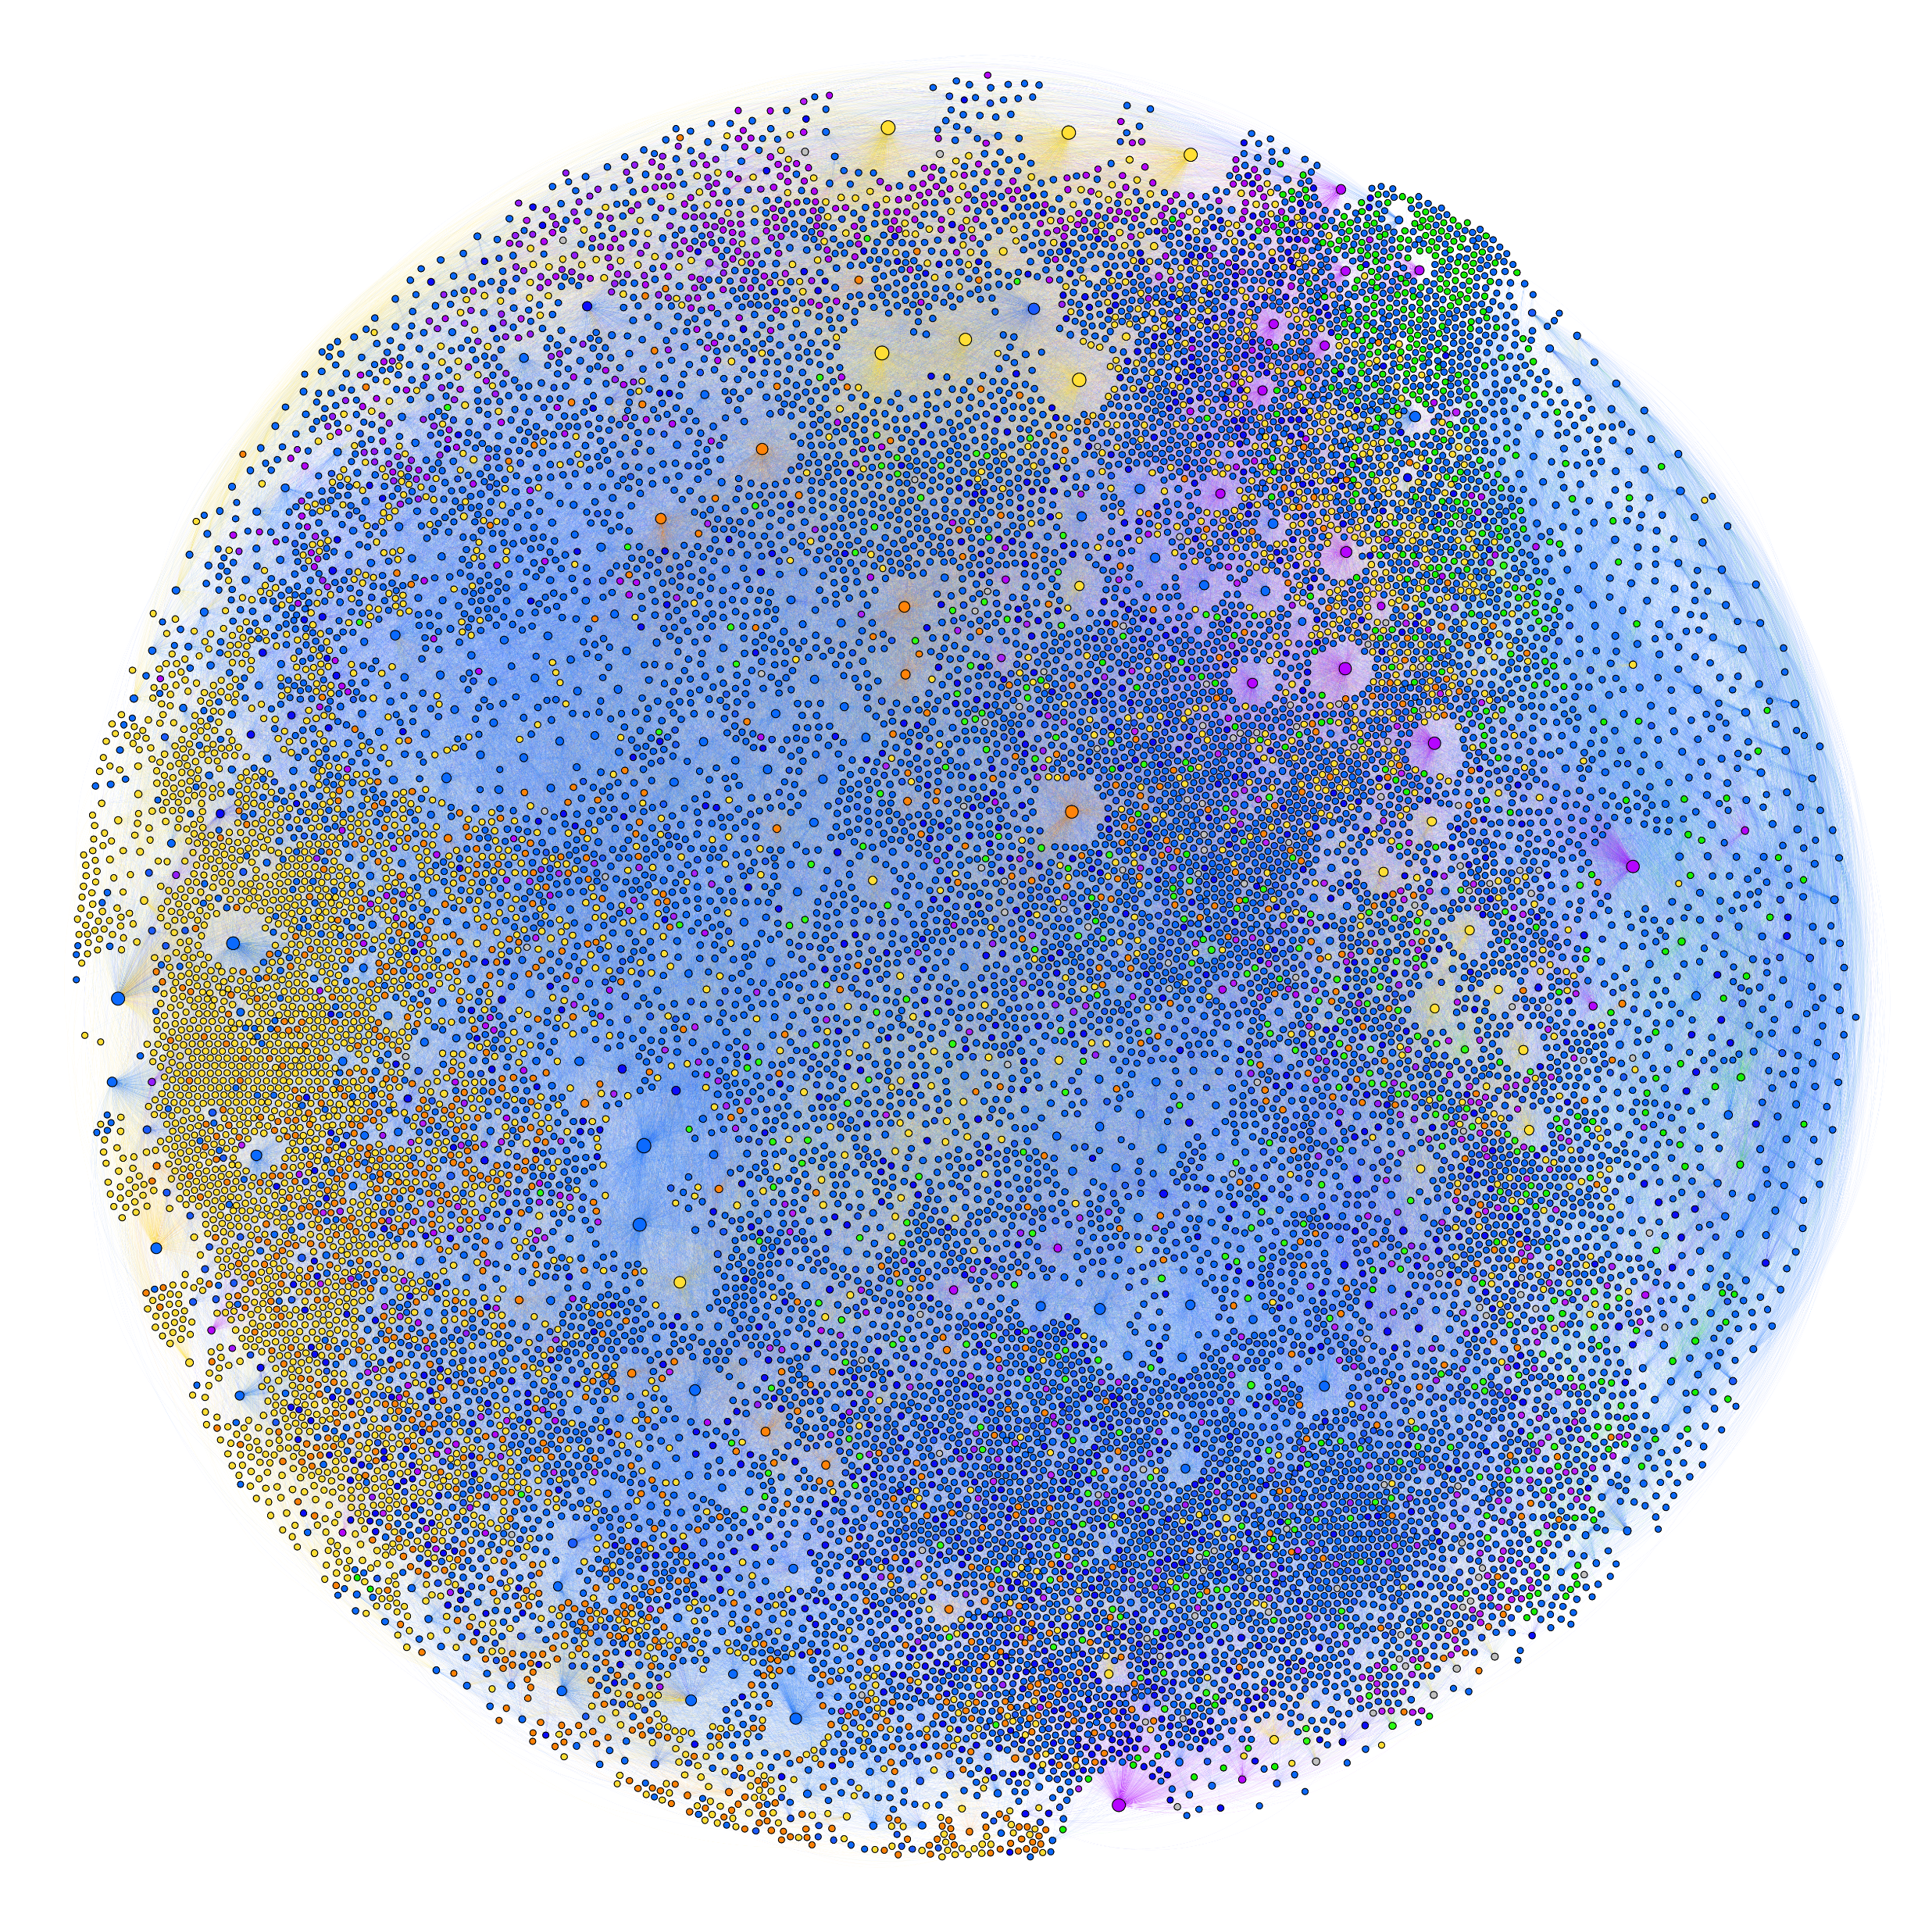


Foreground vs. Background Choices / Assessment
Background
Foreground
Feedback Loops (What if process could be adopted in the entire background?)
System Boundary
P1
FU
P2
P3
P2 or P3?
(ecoinvent 3.8 cutoff)

Slide 12
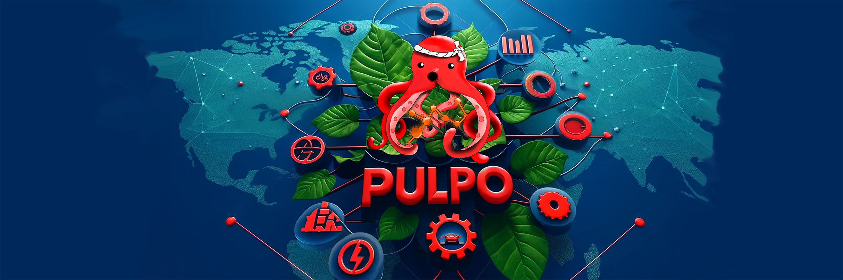



https://github.com/flechtenberg/pulpo
Notes:
With this, I would like to thank you very much for your attention and will be happy to take your questions, comments or feedback.

